Slide 1



2020-2021
Plan de Responsabilidad y Control Local (LCAP)
Distrito Escolar Unificado del Valle de Chino
Reunión de participación asesora de padres del LCAP del sitio
Notes:
Feel free to use this PPT in conjunction with the Annual Update packet and the Goals, Actions, and Services Packet in order to illicit feedback on the School Site LCAP Parent Engagement Meeting Input Form.

Slide 2

Nuestros Objetivos para Hoy
Entender cómo funciona la Fórmula de Financiamiento de Control Local (LCFF) y como apoya las metas del Plan de Responsabilidad de Control Local (LCAP)
Proporcionar la línea de tiempo LCAP actualizada
Revisar las tres metas LCAP del Distrito Escolar Unificado del Valle de Chino y las medidas y servicios relacionados.
Proporcionar información sobre las metas y medidas del LCAP.
Notes:
The objective of today's meeting, is as follows: (state the 3 objectives).
Feel free to use the Collaboration Strategies for Students by modeling a “no opt out environment” to illicit parent participation while reviewing today’s objectives and throughout the presentation when applicable.

Slide 3

¿Qué es la Fórmula de Financiamiento de Control Local? (LCFF)?
Subvenciones Básicas
Subvenciones Complementarias
Subvenciones de Concentración
Los de bajos ingresos, aprendices de inglés, y los jóvenes en hogares temporales o sin hogar generan más fondos por encima de la subvención básica (20%).
La financiación es para aumentar y mejorar los servicios para los grupos especificados anteriormente para mejorar el rendimiento.
4
Cada estudiante genera una subvención básica que financia los costos educativos básicos, tales como: salarios de los empleados, costos de construcción y materiales de instrucción.
Los distritos con más del 55% de bajos ingresos, los aprendices de inglés o los jóvenes en hogares temporal o sin hogar reciben un 50% adicional de la subvención básica.
CVUSD no califica para subvenciones de concentración.
Notes:
The funding formula for Districts changed in 2013-2014 when LCFF was enacted.
LCFF funds include a base level of funding for all Local Education Agencies (LEAs) and extra funding - called "supplemental and concentration" grants - to LEAs based on the enrollment of high needs students (foster youth, English learners, and low-income students). CVUSD receives base grants and supplemental grants.
The LCFF gives school districts more flexibility in deciding how to use state funds. In exchange and as part of the legislation, school districts must work with parents, educators, students, and the community to develop a Local Control and Accountability Plan (LCAP) that shows how they will use these funds to serve students.
With a diversity of student needs, resources in the plan are allocated to support the achievement of all students with additional actions and services provided to English learner (EL), low income (LI), and foster youth (FY) students.

Slide 4

Línea de Tiempo LCAP Actualizada
Pandemia Global COVID-19
Línea de Tiempo Actualizada
Plan Original
Para el 1 de julio del 2020, LCAP de tres años (2020-21 a 2022-23)
Para el 1 de julio del 2020, informe escrito de operaciones
Para el 30 de septiembre, Plan de Continuidad del Aprendizaje y Asistencia
Para el 1 de julio del 2021, LCAP de tres años (2021-22 hasta 2023-24)
Notes:
The LCAP was interrupted due to the pandemic. Alternative plans were put into place to ensure learning continued. The District submitted an Operations Written Report and Learning Continuity & Attendance Plan to the County/State. The LCAP is going to resume and will cover the 2021-22 through 2023-24 school years.

Slide 5
¿Cómo se alinean las tres metas LCAP del distrito con las ocho prioridades del estado de California?
Meta 1: Condiciones de Aprendizaje
Servicios básicos(Prioridad 1)
Implementación de estándares estatales(Prioridad 2)
Acceso al curso(Prioridad 7)
Meta 2: Compromiso
Participación de los padres(Prioridad 3)
Participación de los estudiantes(Prioridad 5)
Ambiente escolar(Prioridad 6)
Meta 3:
Resultados de los Estudiantes
Logro estudiantil(Prioridad 4)
Otros resultados estudiantiles(Prioridad 8)
1
1
Notes:
The state priorities are categorized into three areas:
Conditions of Learning (basic services, implementation of state standards, course access)
Credentialed teacher, common core instructional materials, facilities are in good repair, and students have access to courses that lead to college and career.
Student Outcomes (student achievement and other student outcomes)
Programs and services are in place to promote student learning.
Engagement (parental involvement, student engagement and school climate)
Promote parent engagement and participation in student’s education process.
Students have good attendance and are engaged in their education.
Students are provided a safe learning environment.

Slide 6

¿Cómo se mide el éxito escolar a nivel local?
Servicios Básicos (Prioridad Estatal 1) Maestros con credenciales Materiales educacionales Instalaciones en buen estado | Implementación de los Estándares aprobados por el Consejo Estatal (Prioridad Estatal 2) ELA, Matemáticas, ELD, CTE, Salud, Ciencias Sociales, Educación Física, NGSS, VAPA, Lenguaje mundial | Acceso a un Amplio Curso de Estudio (Prioridad Estatal 7) Grados 1-6 ELA, Matemáticas, Ciencias Sociales, Ciencia, VAPA, Salud, y Educación Física Grados 7-12 ELA, Matemáticas, Ciencias Sociales, Ciencia, VAPA, Salud, Educación Física, Lenguaje mundial, y CTE
Participación de los padres (Prioridad Estatal 3) | Ambiente escolar (Prioridad Estatal 6) | Otros Indicadores seleccionados por el Distrito para apoyar las 8 Prioridades Estatales
1
2
Notes:
Local measures/indicators are used to help determine success. Those measures include basic services, implementation of state standards, access to a broad course of study, parent engagement, school climate, and other selected indicators that support the State's Eight Priorities.

Slide 7



¿Cómo se mide el éxito escolar con los indicadores estatales de CA?
Indicador Académico (Prioridad Estatal 4) Grados 3-8, y 11 CAASPP en ELA y Matemáticas | Indicador del Progreso de los Aprendices de inglés (Prioridad Estatal 4) ABC | Tasas de Suspensión y Expulsión (Prioridad Estatal 6)
Indicador de la Universidad y la Carrera (Prioridad Estatal , 4, 7, y 8) 11th grado CAASPP en ELA y Matemáticas Finalización a-g Finalización de la vía CTE Puntaje de Colocación Avanzada 3+ Inscripción Doble JROTC Sello estatal de alfabetización bilingüe | Tasa de Graduación de la Preparatoria (Prioridad Estatal 5) | Ausentismo Crónico (Prioridad Estatal 5)
10
Notes:
California has established State measures/indicators to determine school success. The measures/indicators include the academic indicator, English Learner Progress indicator, suspension & expulsion rates, college and career indicator, high school graduation rate, and chronic absenteeism.

Slide 8
Indicadores Locales
Desempeño determinado por el distrito, basado en estándares creados por el estado
CUMPLIDO
NO SE CUMPLE
NO SE CUMPLE POR 2 O MÁS AÑOS
1
3
Notes:
CVUSD met all local indicators.

Slide 9
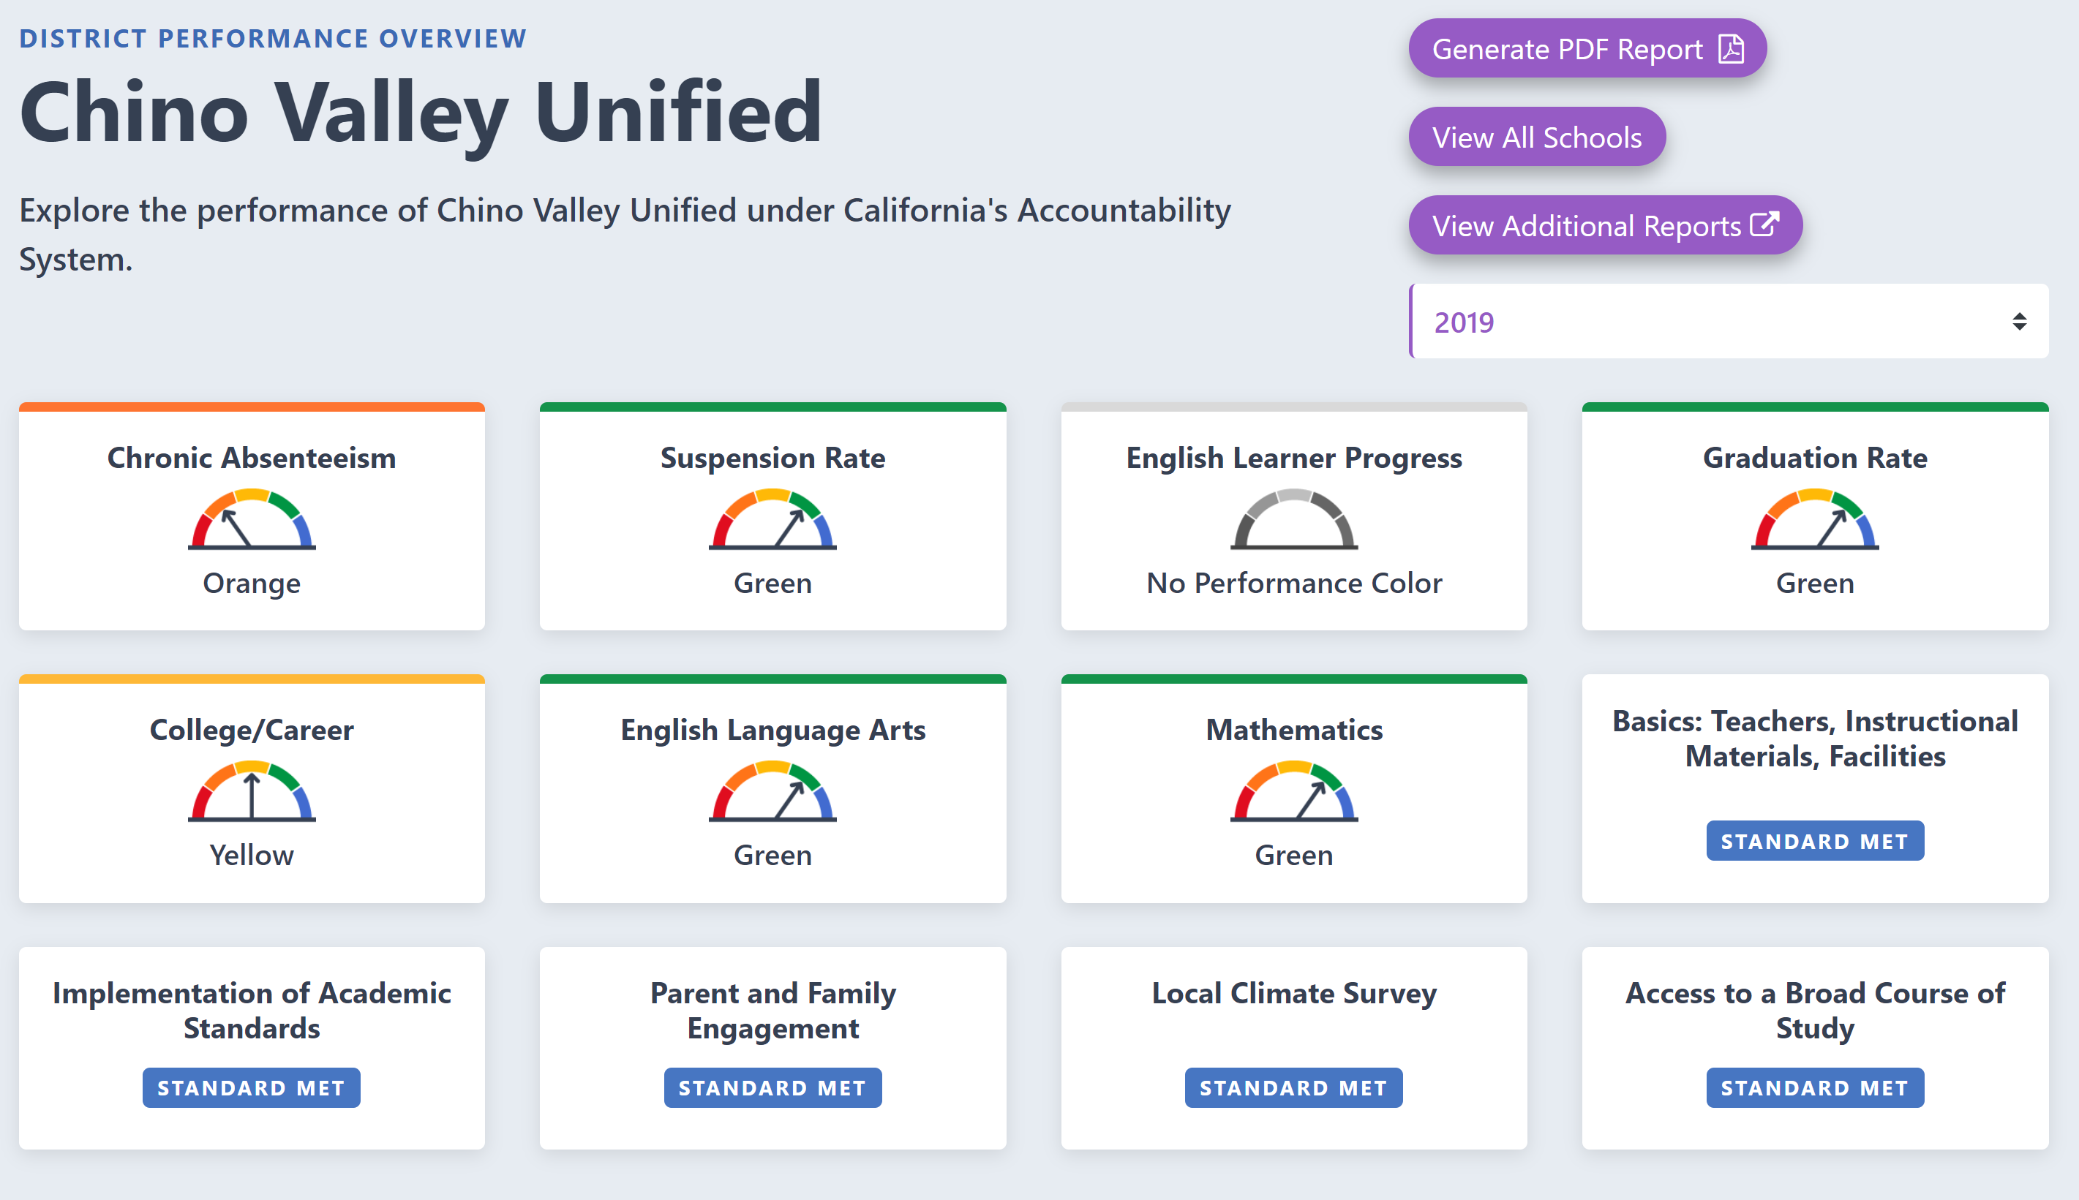
RESUMEN DEL DESEMPEÑO DEL DISTRITO
Generar Informe PDF
Valle Unificado de Chino
Ver todas las Escuelas
Explora el desempeño del Valle Unificado de Chino bajo el Sistema de Responsabilidad de California.
Ver Informes Adicionales
Ausentismo Crónico
Tasa de Suspensión
Progreso del Aprendiz de inglés
Tasa de Graduación
Verde
Verde
Sin color de Rendimiento
Verde
Lengua y Literatura de ingles
Matemáticas
Básicos: Maestros, Materiales Educativos, Instalaciones
Universidad/Carrera
Amarillo
Verde
Estándar logrado
Verde
Implementación de Estándares Académicos
Compromiso de los Padres
Y Familia
Encuesta Local del Ambiente
Acceso a un Curso Amplio de Estudio
Estándar logrado
Estándar logrado
Estándar logrado
Estándar logrado
Notes:
State indicators of overall performance range from blue to red. Areas in “red” identify an area of significant need. CVUSD does not have any overall performance indicators in red and have shown increases in English Language Arts and Mathematics. Due to the pandemic, the State will not publish a Dashboard for the 2019-2020 school year.

Slide 10

Tres (3) Documentos
Actualización Anual
Metas, Medidas y Servicios
Hoja de Aportación
Notes:
Process Check - Participants should have 3 documents:
Annual Update
Goals, Actions, and Services Packet
School Site LCAP Parent Engagement Meeting Input Form

Slide 11


¿Cuáles son las metas LCAP del Distrito 2021-22 al 2023-24?
Meta 1 Condiciones de Aprendizaje | Meta 2 Compromiso | Meta 3 Resultados de los Estudiantes
Prioridades Estatales1, 2, y 7 | Prioridades Estatales 3, 5, y 6 | Prioridades Estatales 4 y 8
A todos los estudiantes se les proporciona un ambiente de enseñanza y aprendizaje de alta calidad. | Los estudiantes, los padres, las familias y el personal están conectados y comprometidos con su escuela para garantizar el éxito de los estudiantes. | Todos los estudiantes están preparados para la universidad y la carrera más allá de la graduación.
1
0
Notes:
CVUSD LCAP is designed to meet the needs of all students, including additional actions/services to support the unduplicated student population. The LCAP is organized by the District’s three adopted goals.

Slide 12
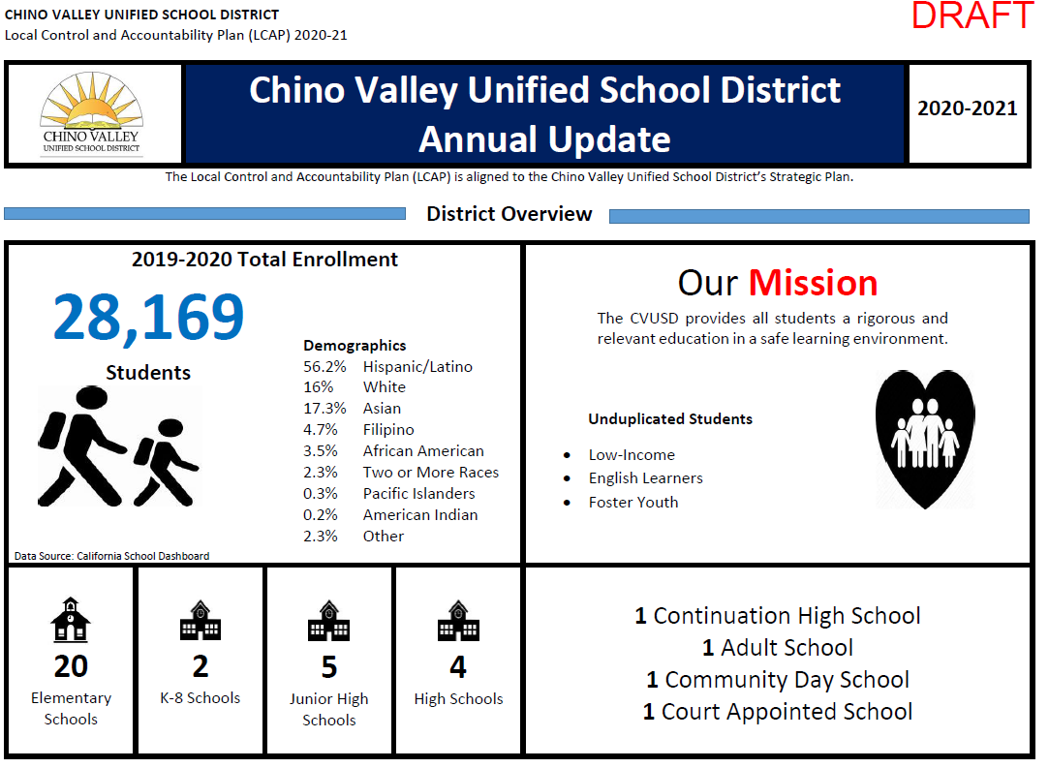
Actualización Anual-Página 1
DISTRITO ESCOLAR UNIFICADO DEL VALLE DE CHINO
Plan de Rendición de Cuentas y Control Local (LCAP) 2020-21
Actualización Anual del Distrito Escolar Unificado del Valle de Chino
El Plan de Rendición de Cuentas y Control Local (LCAP) está alineado con el Plan Estratégico del Distrito Escolar Unificado de Valle del Chino.
Resumen del Distrito
Matriculación Total
Estudiantes
Notes:
Chino Valley Unified School District (CVUSD) offers premier educational opportunities for approximately 27,590 students, from Transitional Kindergarten through 12th grade.
CHANGE IMAGE & DATA: There are 20 elementary schools, two (2) K-8 schools, five (5) junior high schools, four (4) comprehensive high schools, one (1) continuation high school, one (1) adult school, one (1) community day school, and one (1) court appointed school.
The District has an LCFF unduplicated count is approximately 50.7% students that are comprised of 10.2% English Learners, .65% Foster Youth, and 44.9% who are classified as low income.
The racial/ethnic diversity of the school community reflect the following: African American 3.5%, American Indian 0.2%, Asian 17.3%, Filipino 4.7%, Hispanic of Latino 56.2%, Two or More Races 2.3%, Pacific Islander 0.3%, White 16%, Not Reported 2.3%.
CVUSD is home to 18 California Distinguished Schools, some that have been designated Distinguished multiple times. It is also home to a California Gold Ribbon School, National Blue Ribbon School, Title I Academic Achieving Schools, California Honor Roll Schools, California Positive Behavioral Interventions and Supports (PBIS) Coalition Medal Award Winning Schools, and a California Department of Education Service Learning Leaders School. The Golden Bell Award for outstanding programs has been awarded to a District school and career academy. The District was also awarded a Seal of Biliteracy by the State in recognition of students who have studied and attained proficiency in two or more languages.
As one of 547 school districts in the U.S. and Canada, CVUSD has been honored by the College Board with placement on the 5th Annual Advanced Placement (AP) District Honor Roll for increasing access to AP course work while simultaneously maintaining or increasing the percentage of students earning scores of 3 or higher on the AP exams.
Our student test scores traditionally remain at the top of schools throughout the County of San Bernardino and the state. In addition to its stellar academic programs, CVUSD is set apart by its thriving performing arts and athletic programs as well as state and nationally recognized marching bands, color guards, robotics, and Odyssey of the Mind creative challenge teams.
CVUSD has been designated as a Model School Attendance Review Board (SARB) District four times by the State Superintendent of Public Instruction for its attendance improvement and decreasing dropout rates. The SARB process is available for students who are experiencing issues beyond the norm and provides resources for families to overcome barriers that may be contributing to students’ truancy.
The District is responsive to the needs of our students and families through a wide variety of programs. Before and after school care is available for students at several school sites. HOPE Family Resource Centers assist students and their families with food and clothing, counseling, housing information, tutoring referrals and more. In addition, a Health Clinic and its satellite center offer physical exams, illness care, assistance with Medi-Cal approval, and immunizations, including the flu shot. Furthermore,
Parenting forums provided by the District and law enforcement partners inform parents about school trends and how to keep their children safe. With a diversity of student needs, resources in the plan are allocated to support the achievement of all students with additional actions and services provided to English learner (EL), low income (LI), and foster youth (FY) students.

Slide 13



¿Cuáles fueron los Resultados de la Participación del LCAP 2019-20?
2 Encuestas | 86 Reuniones | 16,155 Partes interesadas que participan | 18,402 Comentarios
9
Notes:
As part of the LCAP process, and with your assistance, there was a significant amount of stakeholder engagement that led to the contribution of this year’s plan.
Reflective of our stakeholder feedback, CVUSD will continue to provide supports in the following:
-Investing in technology and instructional technology
-Providing supplemental education and intervention support
-Maintain and support learning opportunities through a Multi--Tiered System of Support for Academic (MTSS-A) and Multi-Tiered system of Support for Behavior (MTSS-B)
-Increase access and enrollment in all required areas of study
-Update instructional materials for transitional kindergarten
-Expand preschool inclusion program for students with disabilities,
-Provide crisis response training
-Continue CTE pathways at the high schools,
-Provide tutoring services for foster youth and homeless students
-Increase college awareness at all levels

Slide 14
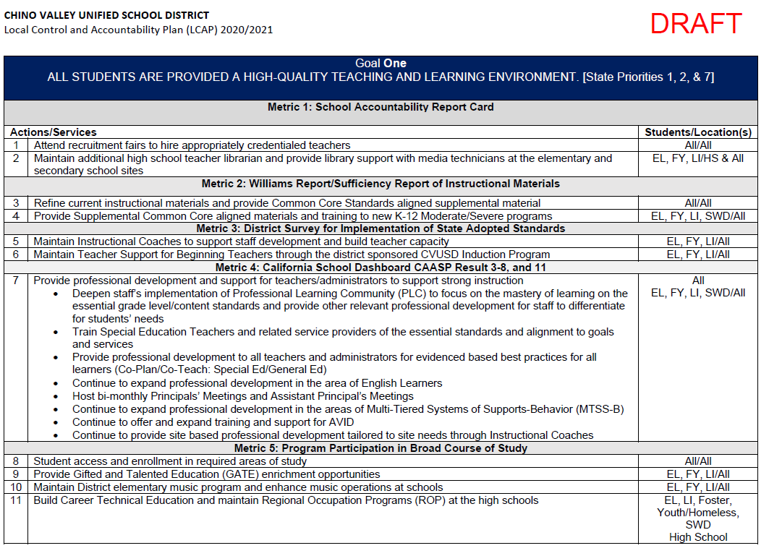
Metas, Medidas y Servicios
Notes:
CVUSD made progress in implementing most actions and services identified in LCAP Goal 1 in the 2018-2019 school year. Based on stakeholder input, more technology support for the schools remains a high need. The majority of “modified” actions/services were due to changes in the fiscal apportionment for those actions/services. Additional actions/services (18- 24) emerged as a result of student need and stakeholder input for the 2019-2020 school year.
The actions and services were well planned and demonstrated high achievement of LCAP Goal 1 as follows:
- No teaching misassignments reported in the core academic areas due to the recruitment efforts of hiring high quality staff in a timely manner.
- Textbooks in English language arts and Advanced Placement (AP) courses have been purchased to support standards-based instruction and AP courses.
- Current instructional materials have been analyzed by curriculum committees to ensure standards are aligned to support a clear focus for student learning.
- Implementation of district-wide professional development through Professional Learning Communities (PLCs) was effective; staff responded with the highest rating of 4 out of 4 regarding comfort level with
elements of PLCs and a 3 out of 4 in developing common formative assessments to improve student outcomes.
- A concerted effort in providing a quality learning environment yielded 100% of our schools obtaining a good or higher rating on the Facility Inspection Tool (FIT) report.
- Teaching staff having access to up to date technological equipment to advance instruction.
----------------------------------------------------------------------------------------------------------------------------------------------------------------------------------------
All actions and services outlined in LCAP goal 2 were implemented in the 2018-2019 school year and the majority remain. Additional actions/services (#37 & 38) emerged as a result of student need and stakeholder input for the 2019-2020 school year.
Most aspects of the goal which include the expected annual measurable outcomes were met for LCAP Goal 2. There has been a continued District-wide effort in promoting parent and student engagement with over 17,000 voices heard and the results and the 2018-19 K-12 Insight Survey results are as follows:
93% of participating parents strongly agree/agree that families are encouraged to attend school-sponsored activities.
84% of participating students strongly agree/agree there is a teacher, counselor, or other staff member to whom they can go for help with a school problem.
Even with the strong results, the District will continue to inform parents and families of District programs and services to strengthen and support engagement and student learning.
In addition to parent engagement, the District’s Multi-Tiered Systems of Support for Behavior (MTSS-B)-PBIS and professional development yielded great progress in LCAP Goal 2. Tier 1 prevention services have begun to reflect in an overall decrease of “at-risk” students in elementary through junior high schools.
Attendance rates continue to surpass the State’s attendance rate. According the P2 state report CVUSD is at 96.37% as of March 22, 2019.
HOPE Center provided Life Skills and necessities to over 2,000 unduplicated students/families h (e.g. clothing, hygiene products, school supplies).
------------------------------------------------------------------------------------------------------------------------------------------------------------------------------
CVUSD implemented all actions and services identified in LCAP Goal 3 and most aspects of the goal which include the expected annual measurable outcomes were met in the 2018-2019 school year. The LCAP Goal 3 actions and services contributed to the District’s overall academic growth. Staff development for Integrated ELD has significantly contributed to improvements made by our English learners as evidenced by the District’s ELPAC scores; and continued services outlined in Goal 3 remain for the 2019-2020 school year.
2019 CAASPP data revealed the following: TBA

Slide 15
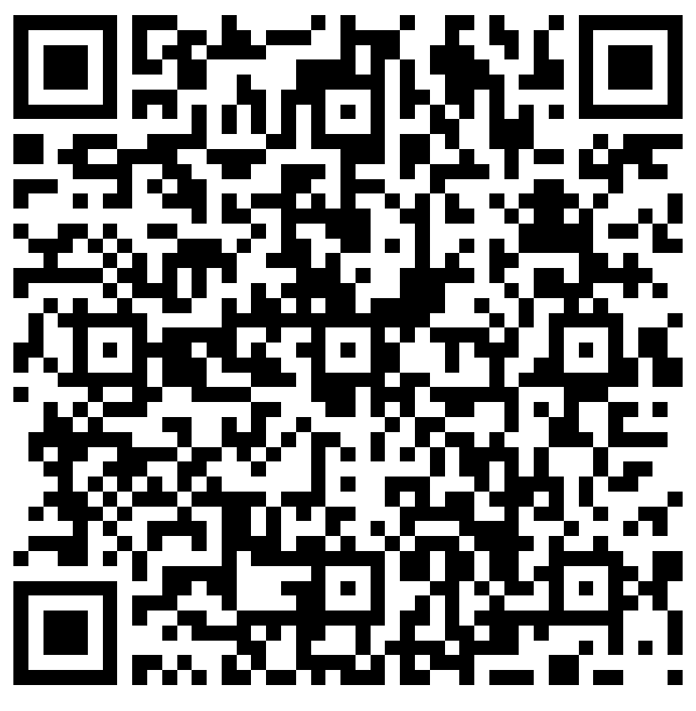
Formulario de Contribución Código QR
Notes:
Explain how the School Site LCAP Parent Engagement Meeting Input Form will be filled out during the presentation

Slide 16
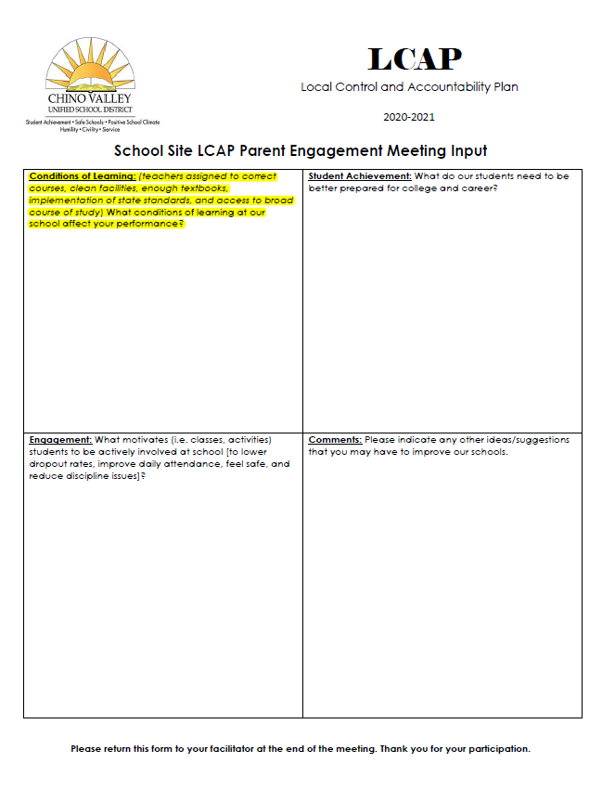



Meta 1 Condiciones de Aprendizaje
Prioridades estatales 1, 2, y 7
A todos los estudiantes se les proporciona un ambiente de enseñanza y aprendizaje de alta calidad.
Revisar el progreso de la meta 1 del LCAP y las medidas y servicios relacionados.
Obtenga comentarios sobre la meta 1 del LCAP y las medidas y servicios relacionados
Notes:
Review LCAP Goal 1 from Annual Update packet and the Goals, Actions, and Services Packet together to obtain feedback on form

Slide 17
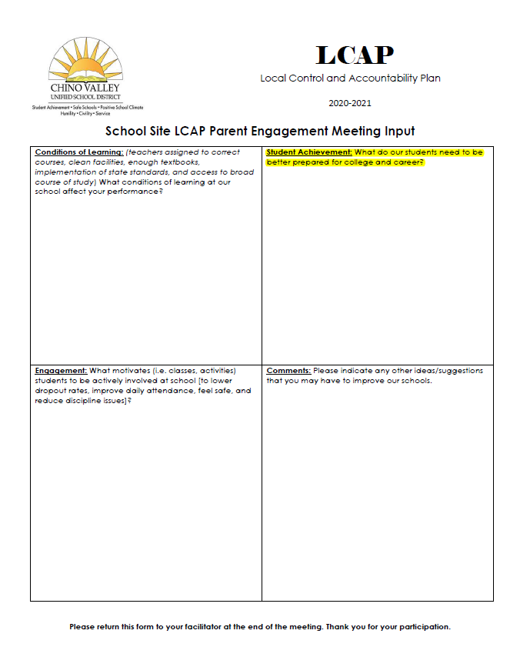

Meta 2 Compromiso
Prioridades Estatales 3, 5, y 6
Los estudiantes, los padres, las familias y el personal están conectados y comprometidos con su escuela para garantizar el éxito de los estudiantes.
Revisar el progreso de la meta 2 del LCAP y las medidas y servicios relacionados.
Obtenga comentarios sobre la meta 2 del LCAP y las medidas y servicios relacionados
Notes:
Review LCAP Goal 2 from Annual Update packet and the Goals, Actions, and Services Packet together to obtain feedback on form

Slide 18
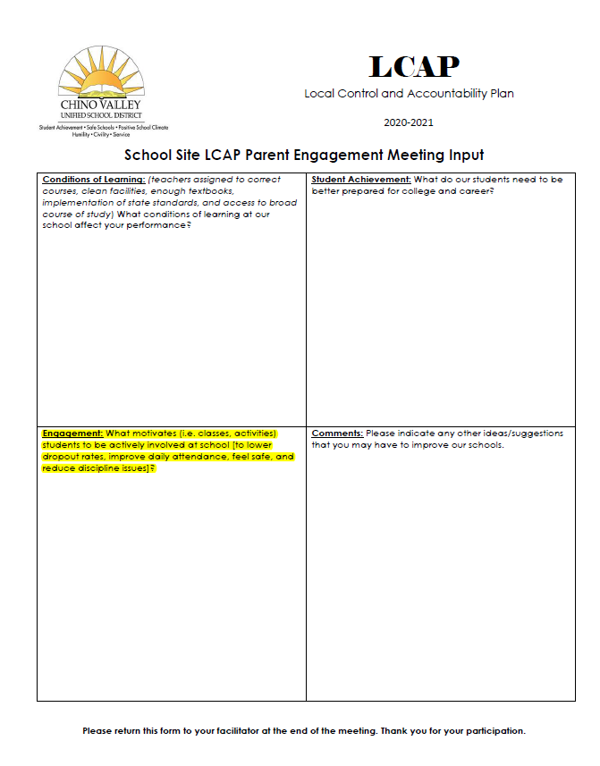
Meta 3 Resultados de los Estudiantes
Prioridades Estatales 4 y 8
Todos los estudiantes están preparados para la universidad y la carrera más allá de la graduación.
Revisar el progreso de la meta 3 del LCAP y las medidas y servicios relacionados.
Obtenga comentarios sobre la meta 3 del LCAP y las medidas y servicios relacionados
Notes:
Review LCAP Goal 3 from Annual Update packet and the Goals, Actions, and Services Packet together to obtain feedback on form

Slide 19
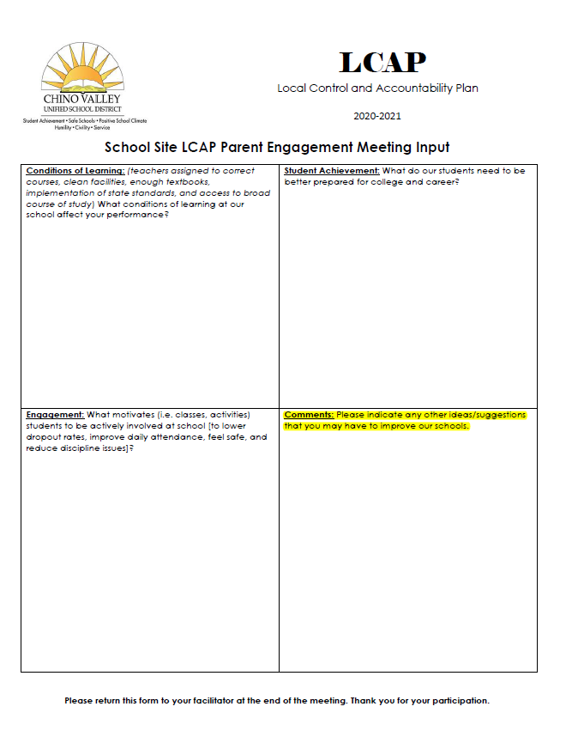
¡Gracias por su valiosa contribución!
Por favor recuerde dejarnos su hoja de contribucion LCAP.
Notes:
Don’t forget to collect School Site LCAP Parent Engagement Meeting Input Form as parents exit

